Slide 1

Big Data Technology Final Project
By:
Adonay Gebrerufael
Hein Htet Zaw
Misgana Gebrerufael
Tsigereda Hagos

Slide 2

Wholeness of Project
In this project, an array of technologies such as Kafka, Spark, Hive, Tableau, and more were utilized to extract data from a CSV file and conduct thorough analysis. Following the analysis, the findings were translated into dynamic charts and histograms for effective visualization.
Exploring the Science and Technology of Consciousness, we recognize creation's layered nature and engage in Transcendental Meditation as a means to uncover the unified field of consciousness. Through regular practice, we witness firsthand the positive impacts in our daily lives, often finding nature aligning to support our journey towards understanding consciousness on a deeper level.

Slide 3
We designed a complete process to capture real-time data from the Stock Market Alpha Vantage and display it using the visualization tool Tableau. Furthermore, store this data permanently on Hive for future reference.
Combine the strengths of Spark Streaming, Spark SQL, and data visualization tools to process, analyze, and visualize real-time stock market data for informed decision-making
Additionally, perform data analysis using Spark SQL by executing queries, storing the results in Hive, and displaying them in Tableau.

Slide 4
Tools used for development
Stock Market Alpha Vantage API
Kafka (stream-processing)
spark streaming
spark SQL
HIVE
Tableau

Slide 5





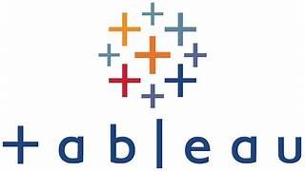

End-to-End Data Streaming pipeline.
.

Slide 6
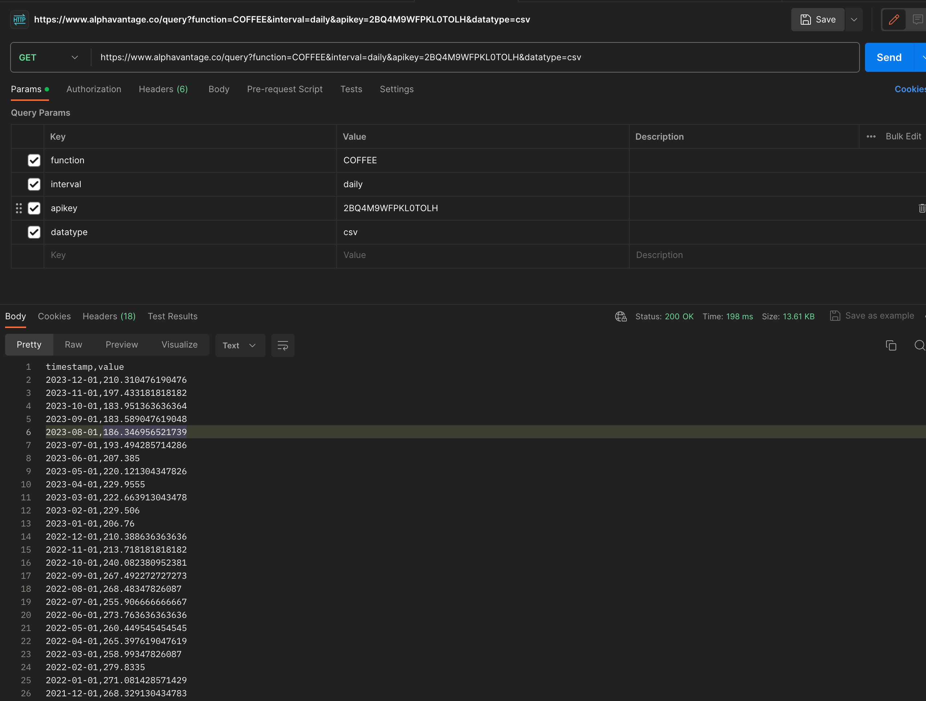
The Real API result from the postman

Slide 7
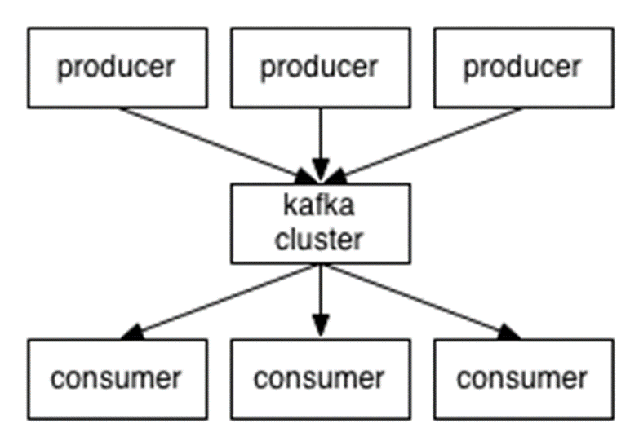
What is kafka?
Apache Kafka is a high-performance technology for streaming data in real-time, which can efficiently process an enormous volume of events every day. Originally designed as a messaging queue, Kafka is built on a distributed commit log abstraction. Since its development and release as an open-source platform in 2011, Kafka has become the widely accepted industry standard for managing data flow.

Slide 8
Spark Streaming
Spark Streaming is a powerful, scalable, and fault-tolerant stream processing module designed for live data streams. Capabilities include high-throughput processing, fault tolerance, and scalability. Ideal for real-time predictions and recommendations. Integration with Spark SQL, HBase, and Hive

Slide 9
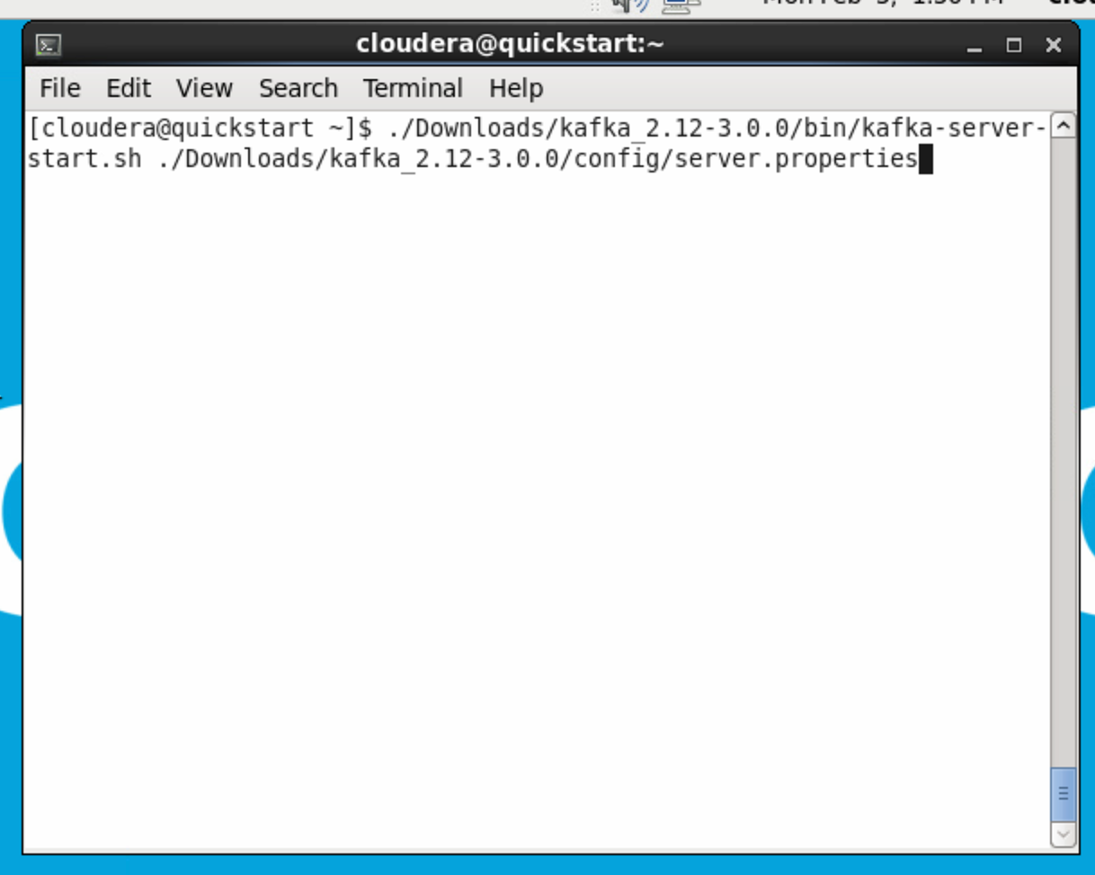
To Run the Project Step 1 -> Run Command to start Kafka Server

Slide 10
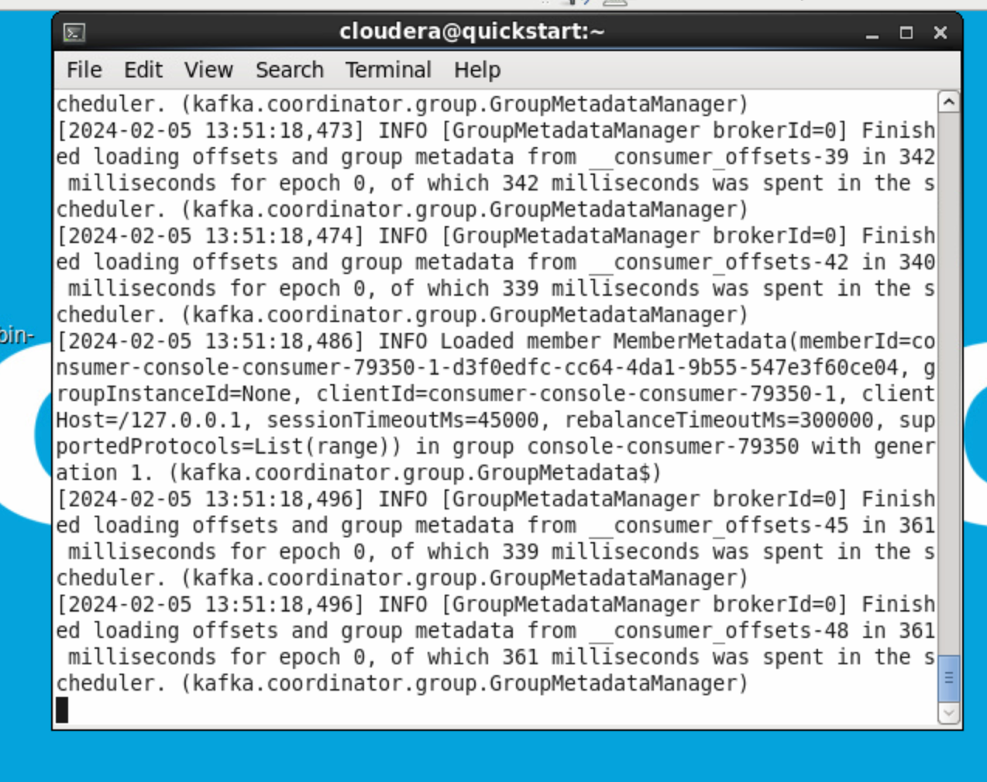
kafka server running

Slide 11
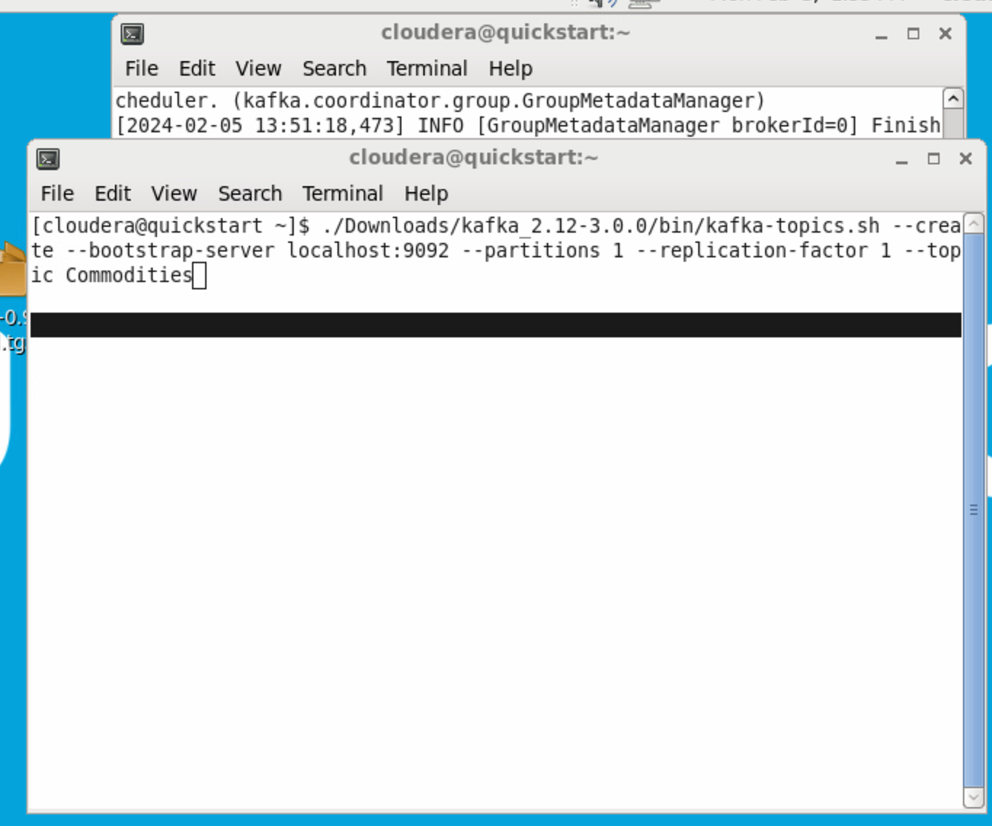
Step 2-> Create Topic name Commodities With Replication Factor 1 and Partitions 1 #kafka cab be fault tolerance by setting up replications factor to 2,3 or more

Slide 12
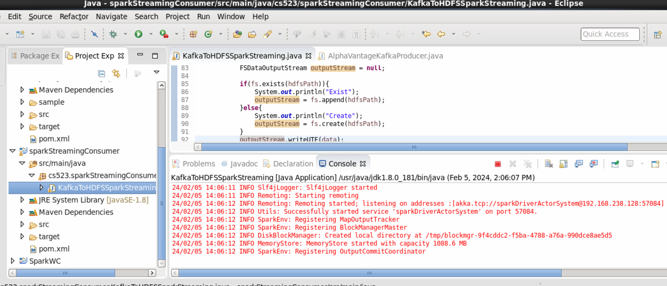
Step 3->Compile Kafka Producer Project into jar

Slide 13
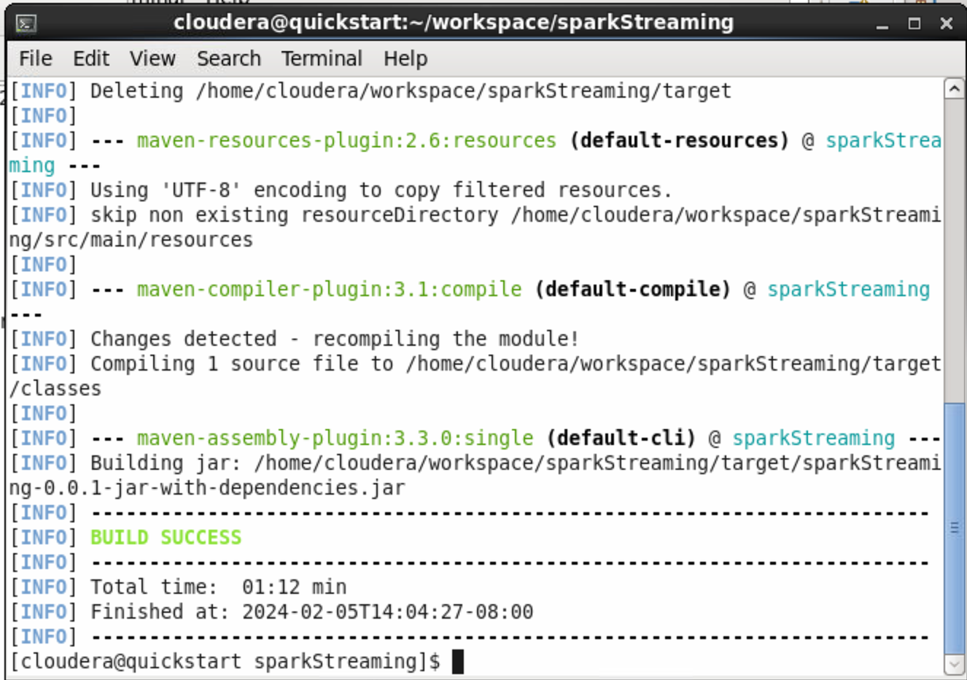
Step 4->Compile Kafka Producer Project into jar

Slide 14
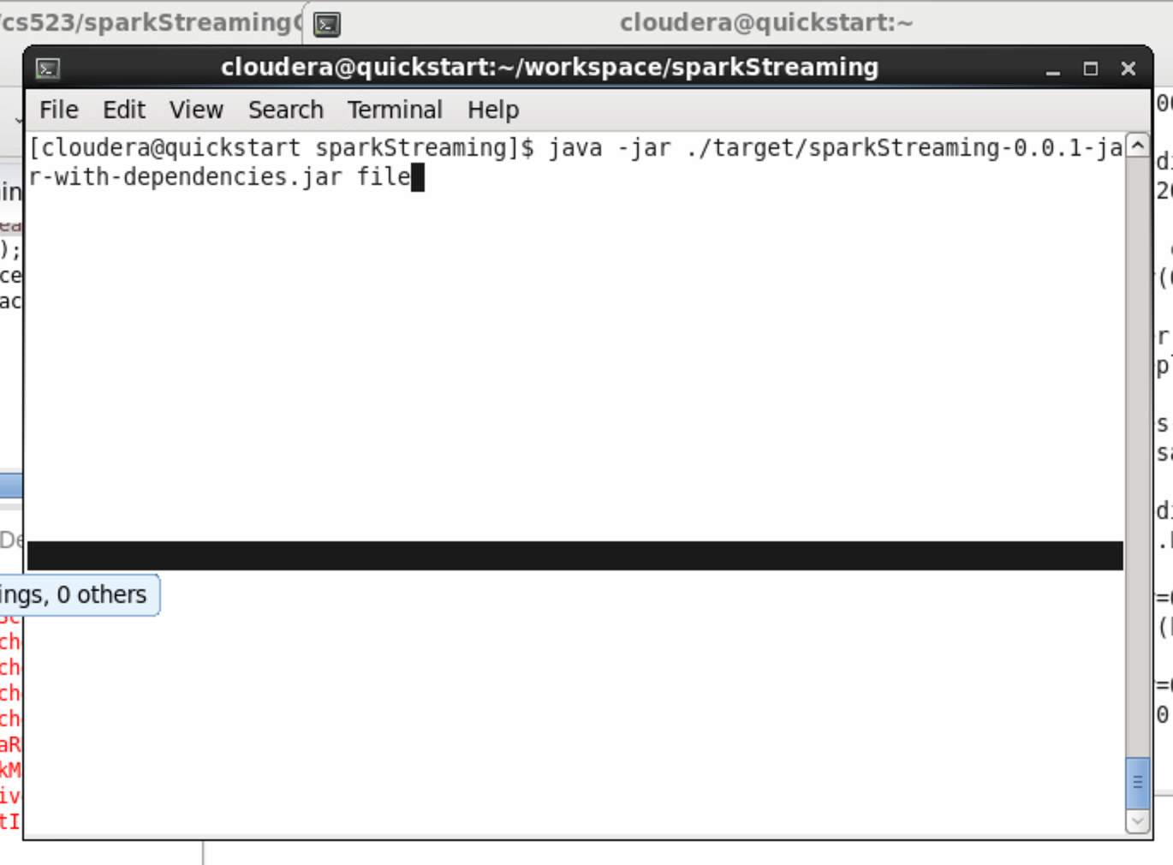
Step 5 -> Run Kafka Producer jar

Slide 15
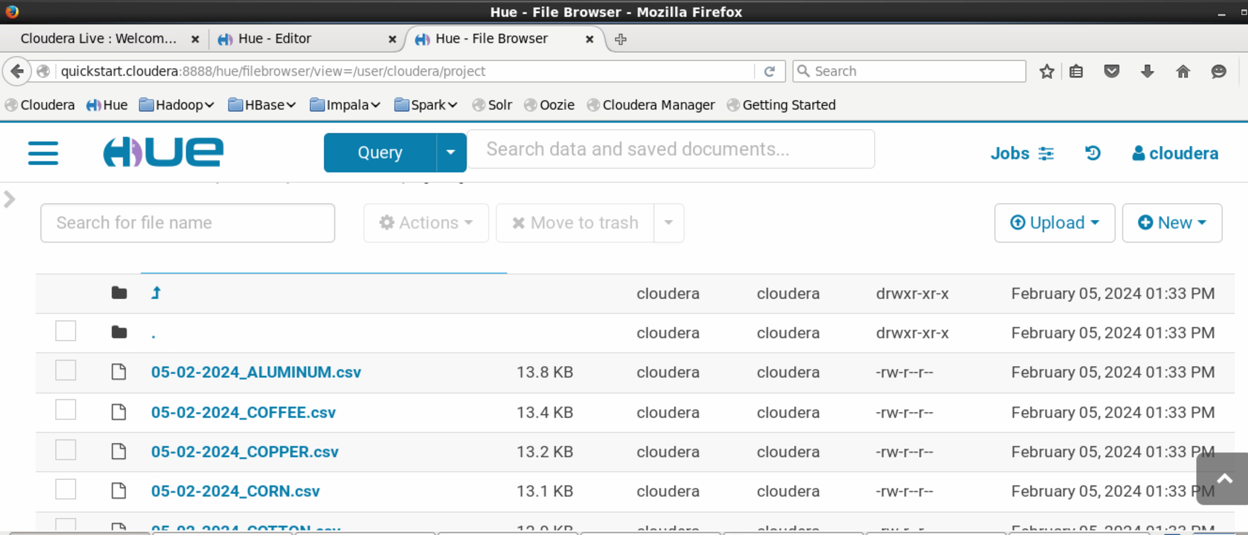
Step 6-> Check hdfs file in Hue

Slide 16
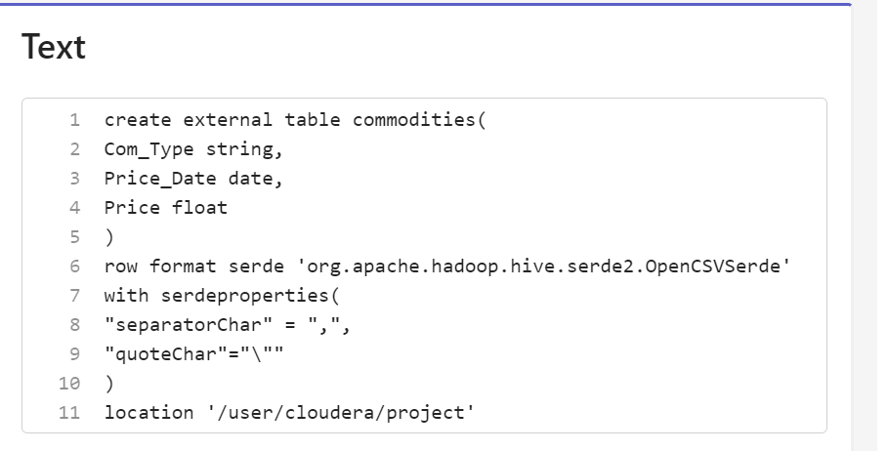
Step 7 -> Create Hive Table using following query

Slide 17
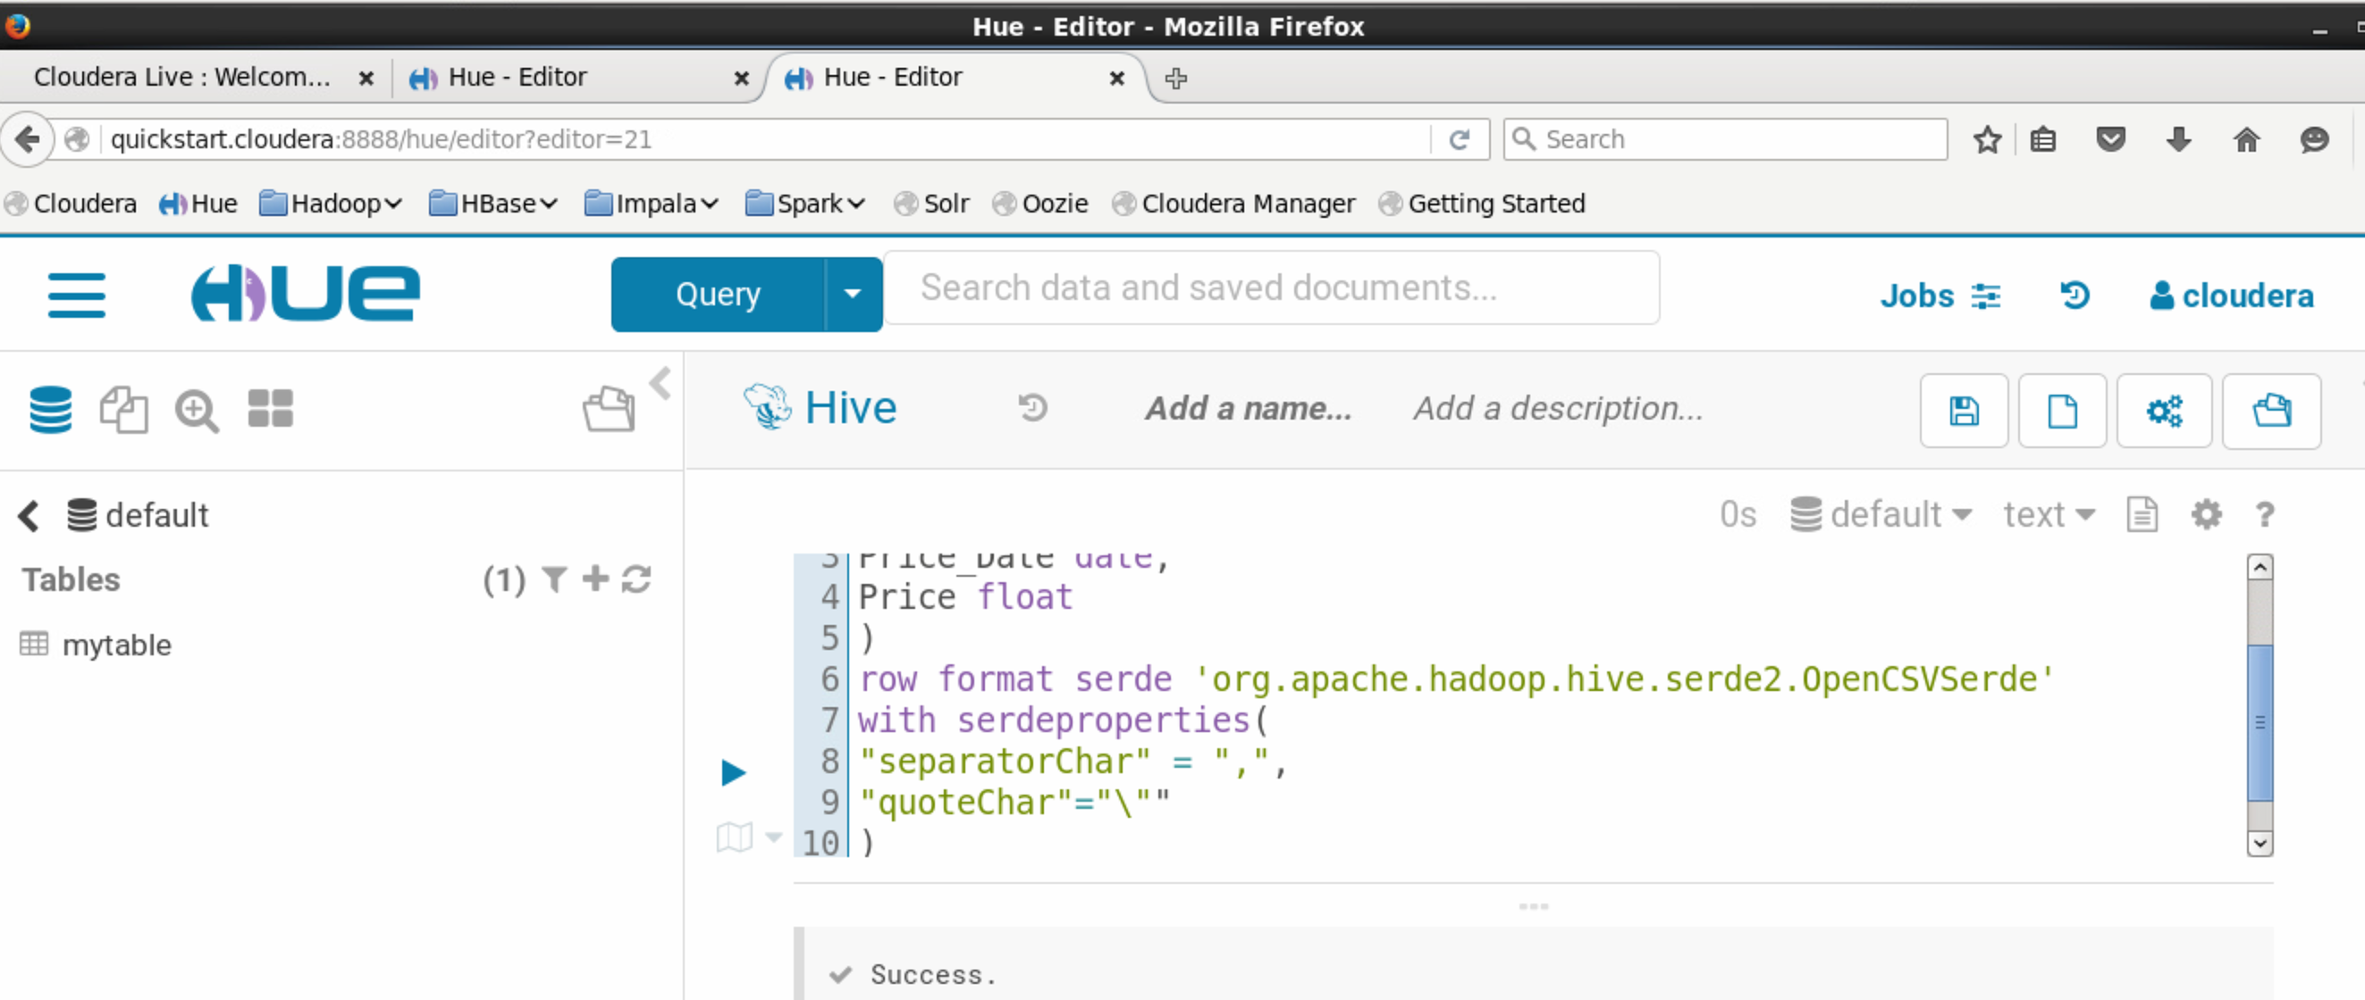

Slide 18
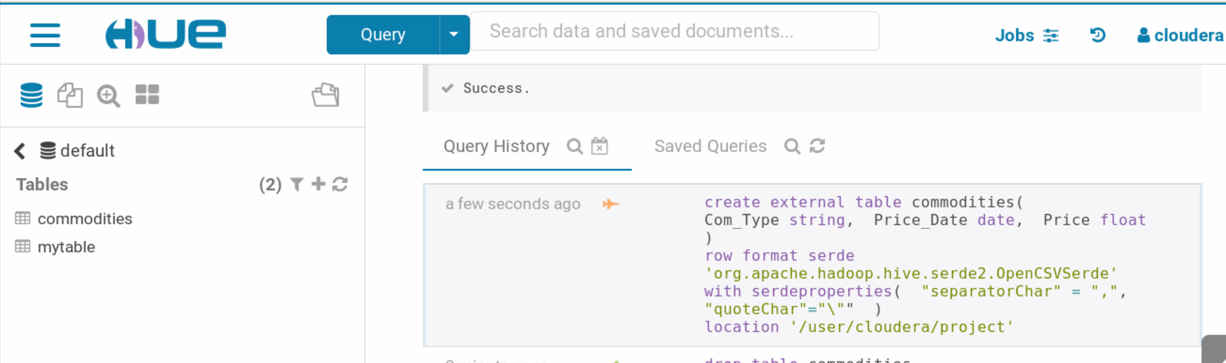

Slide 19
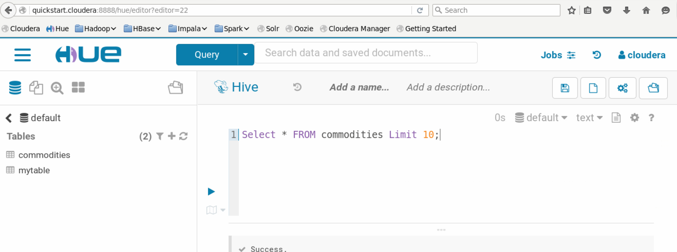

Slide 20
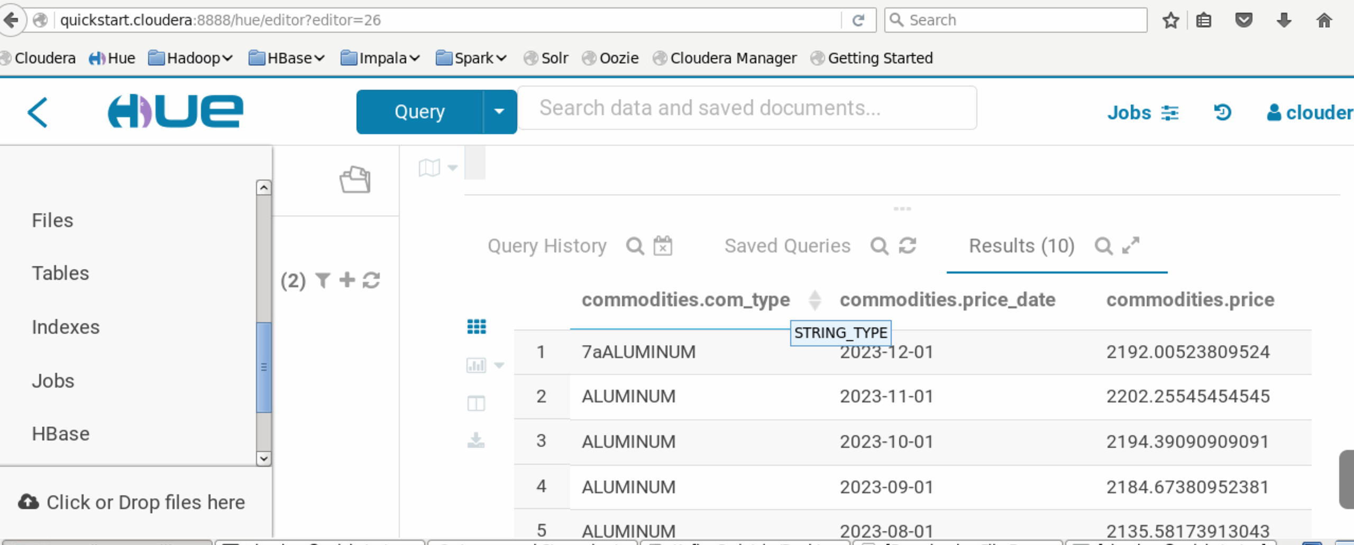
Step 8-> Result

Slide 21
Tableau
Tableau Desktop is a business intelligence and data visualization tool that can be used by anyone. It specializes in transforming boring tabulated data into eye-candy graphs and representations. With tableau desktop, you can enjoy real-time data analytics by directly connecting to data from your data warehouseTableau Desktop

Slide 22
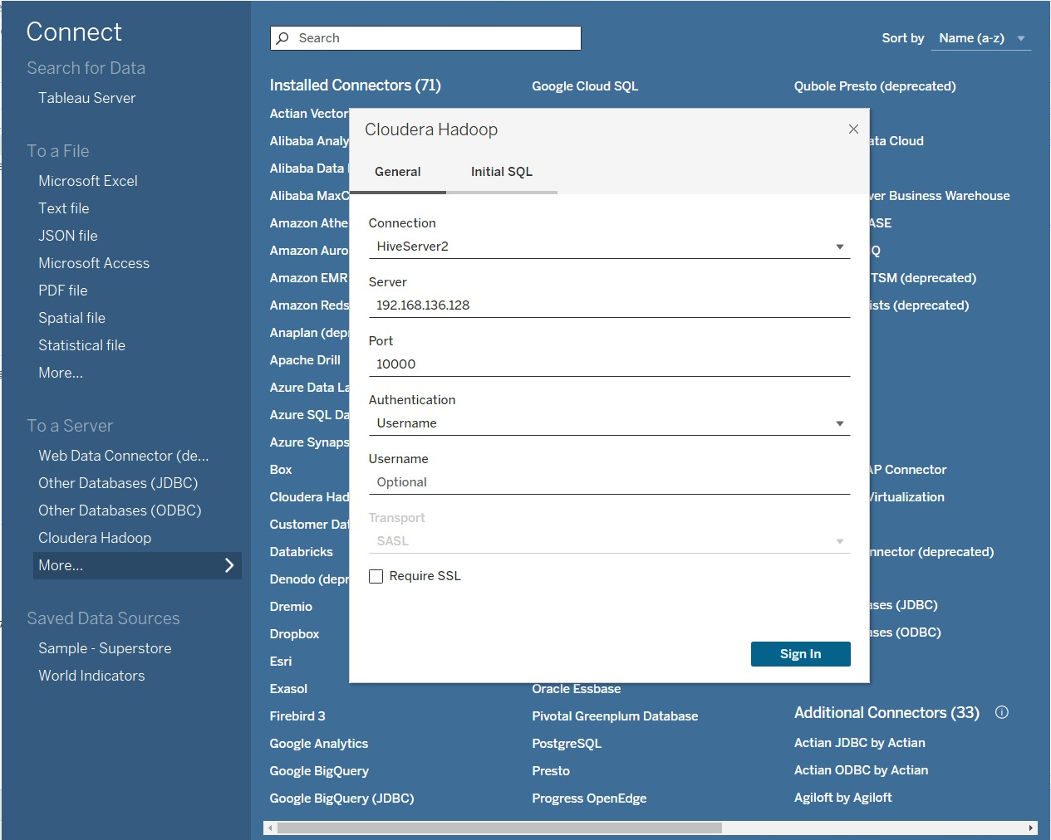
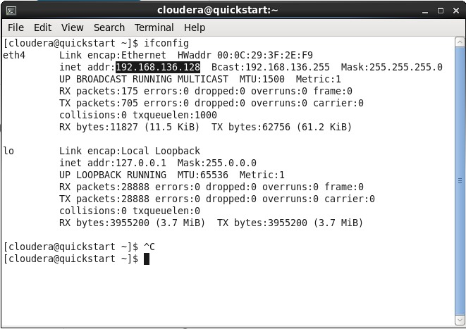
How To Connect Tableau With Cloudera Hadoop Step 9-> get VM's IP address

Slide 23
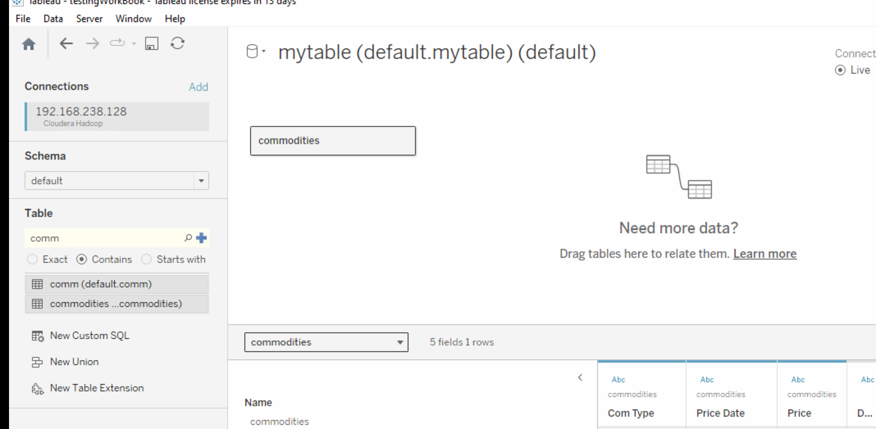
Step 10-> find the Hive Table and drag and drop

Slide 24
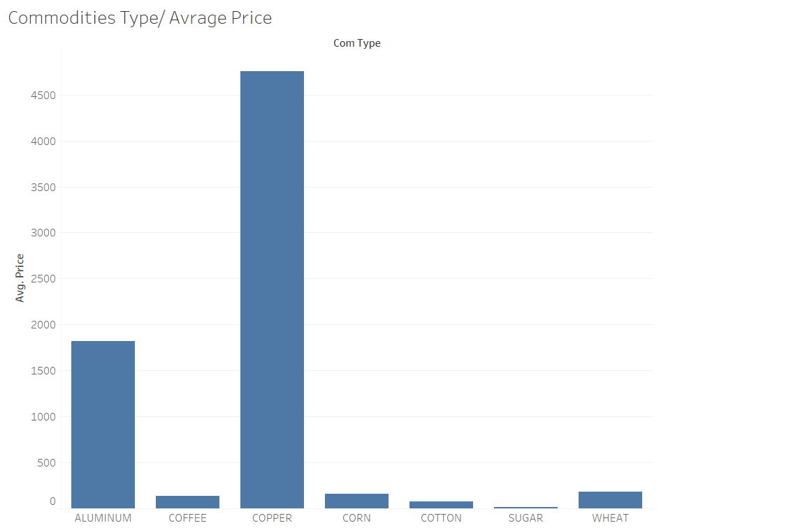

Slide 25
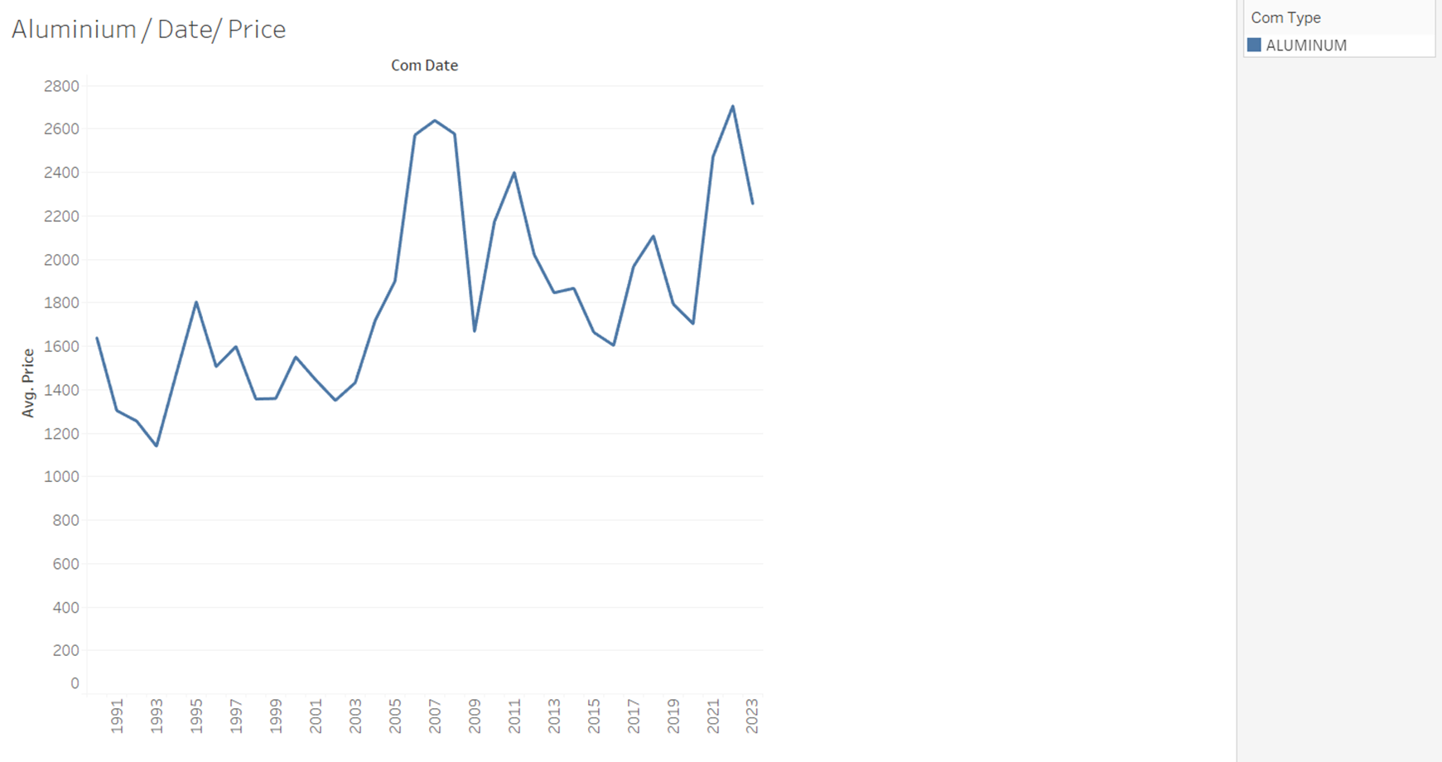

Slide 26
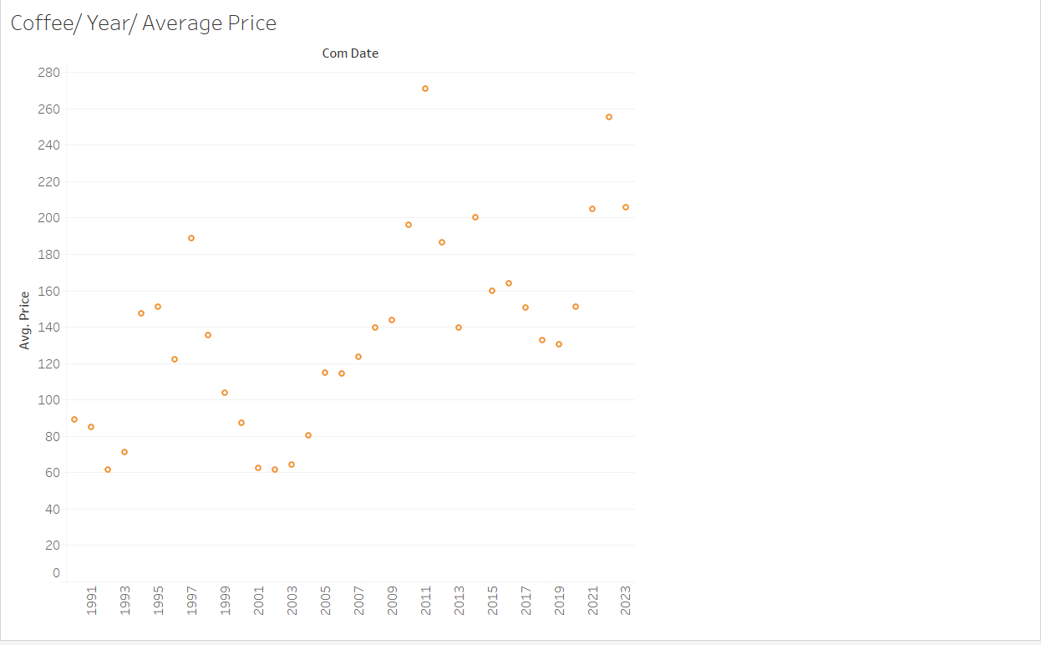

Slide 27
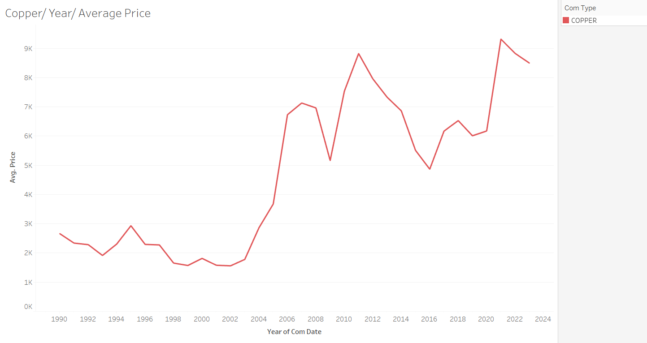

Slide 28
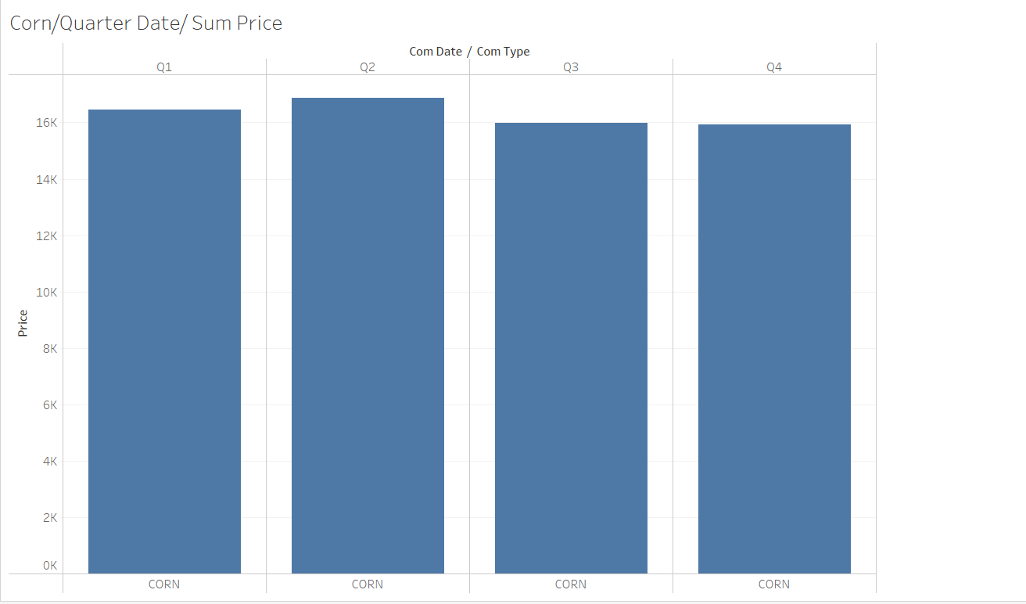

Slide 29
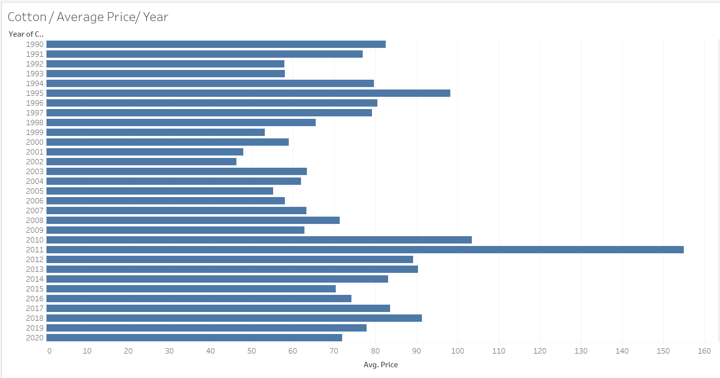

Slide 30
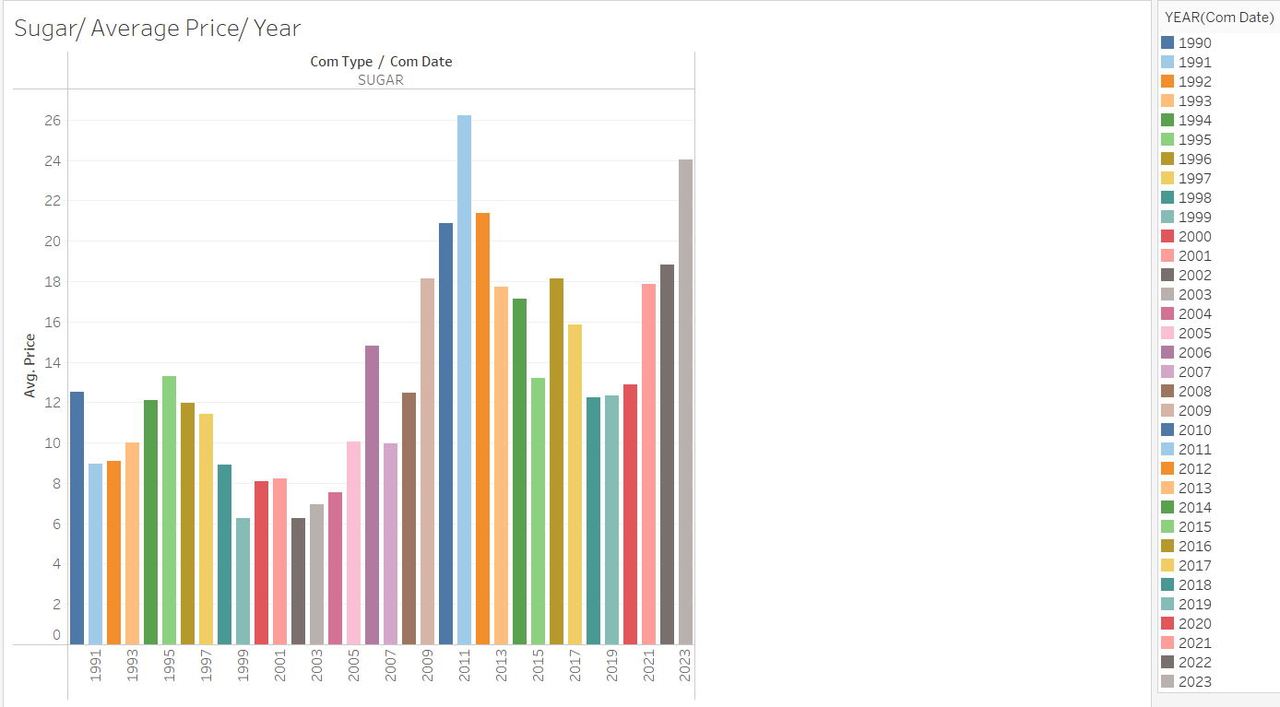

Slide 31
